Slide 1

Chapter 13: The Aggregate Demand-Aggregate Supply Model
Wayne Geerling
University of Texas

Slide 2
Big Questions
1. What is the aggregate demand–aggregate supply model?
2. What is aggregate demand?
3. What is aggregate supply?
4. How does the aggregate demand–aggregate supply model help us understand the economy?

Slide 3
Macroeconomics
In macroeconomics, there are two paths of study:
Long-run growth and development
Short-run fluctuations, or business cycles
Long-run growth & development
Focuses on theories and policies that affect economies over several decades.
Short-run fluctuations, or business cycles
Focuses on time horizons of five years or less.

Slide 4
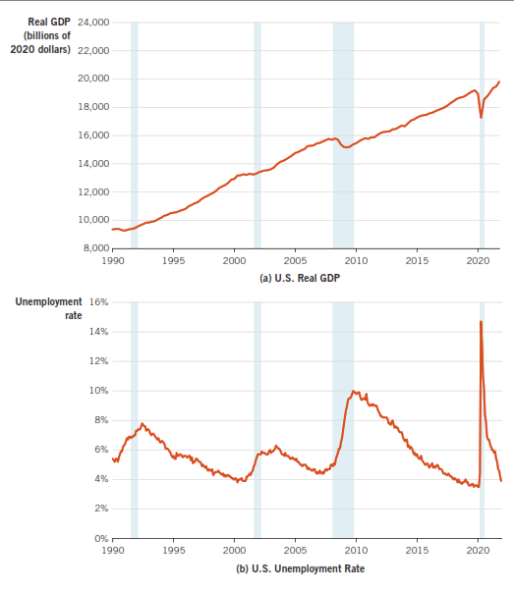
U.S. Real GDP Growth, Unemployment Rates & Recessions, 1990-2021

Slide 5
AD & AS Model
Model used to study business cycles.
Built on demand & supply model.
Considers demand & supply for all final goods in an economy.
Aggregate = total.

Slide 6
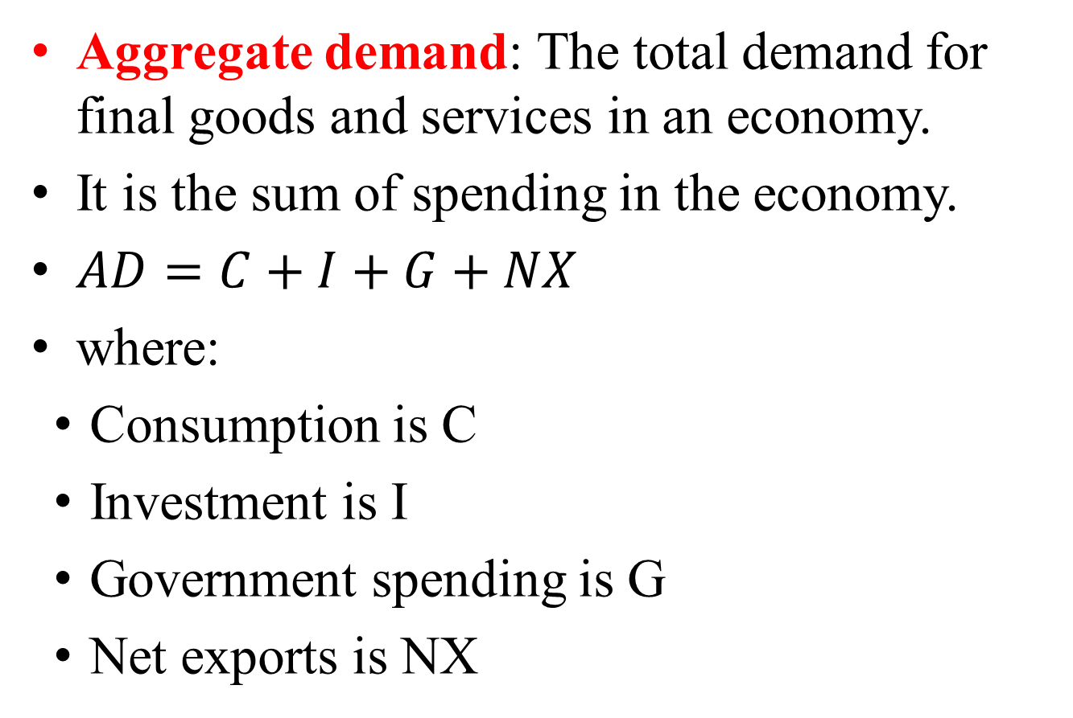
Aggregate Demand
Aggregate demand: The total demand for final goods and services in an economy.
It is the sum of spending in the economy.
$AD=C+I+G+NX$
where:
Consumption is C
Investment is I
Government spending is G
Net exports is NX

Slide 7
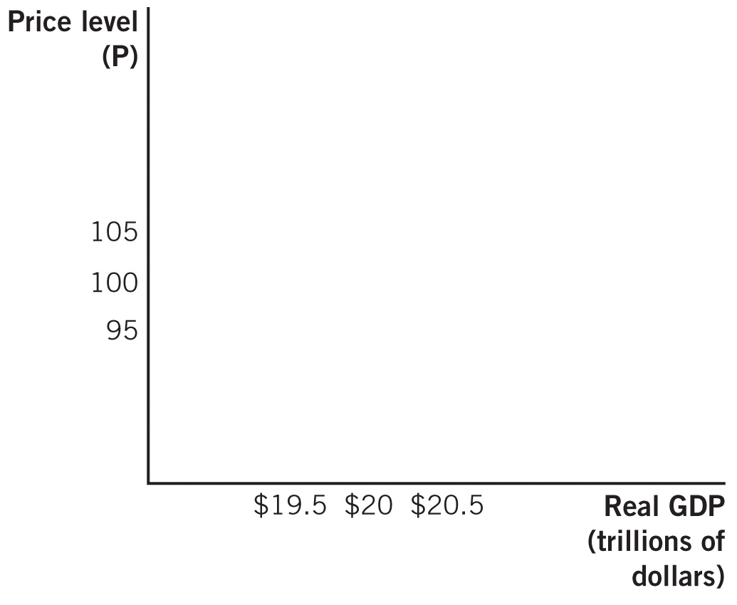
Aggregate Demand

Slide 8

Slope of the AD Curve
There are 3 reasons why the quantity of AD & the price level are negatively related are:
The wealth effect.
The interest rate effect.
The international trade effect.

Slide 9



Wealth Effect
Wealth effect: The change in the quantity of AD that results from wealth changes due to price-level changes.
Wealth: The net value of one’s accumulated assets.
This effect is related to consumption.

Slide 10
Interest Rate Effect
Interest rate effect: Occurs when a change in the price level leads to a change in interest rates & therefore in the quantity of AD.
This occurs through the loanable funds market.
Changes in the price level affect saving.
This directly impacts the supply of loanable funds.
Example: If price levels (up), saving (down), IR (up), I (down)

Slide 11
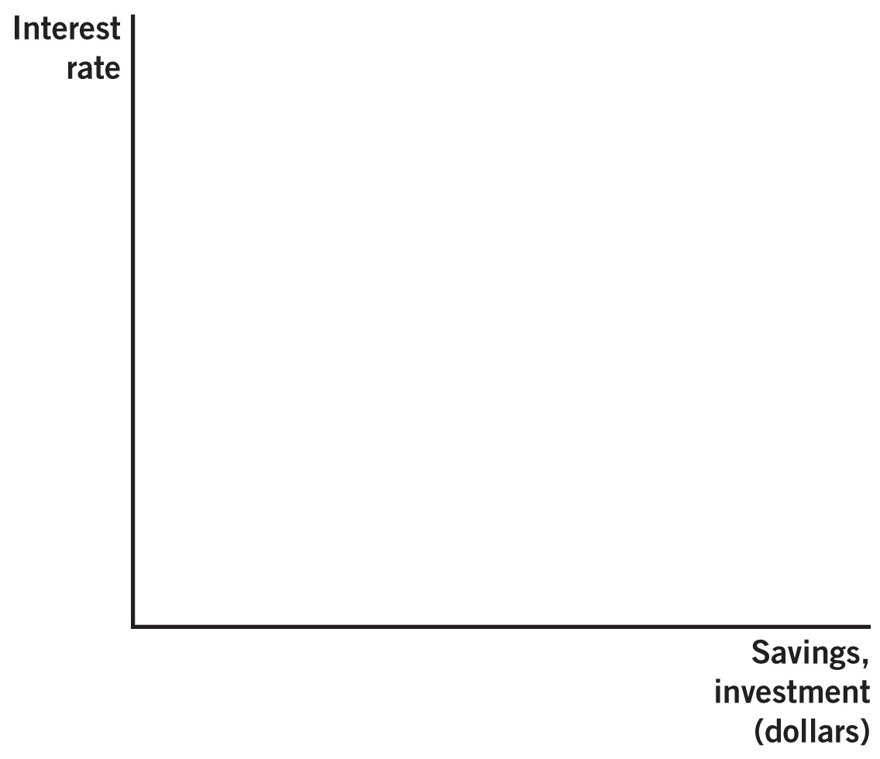
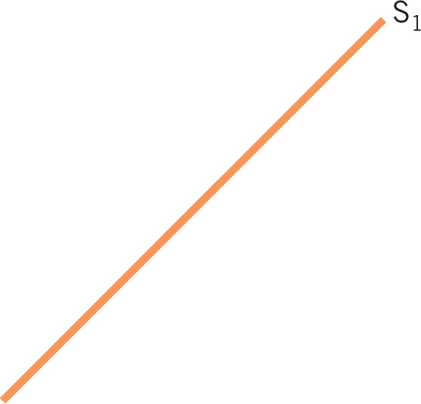
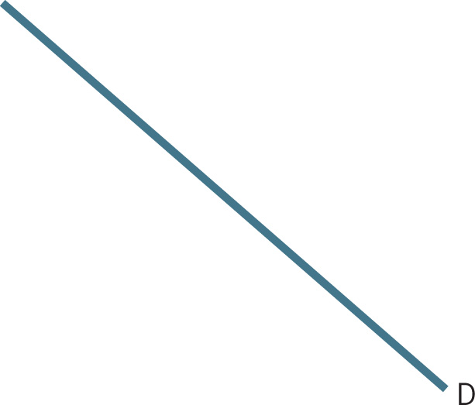

Slide 12

International Trade Effect
International trade effect: Occurs when a change in the price level leads to a change in the quantity of net exports demanded.
Happens due to changes in relative price levels.
Example: If Japanese goods are cheaper relative to Australian goods, more people will demand Japanese goods.

Slide 13
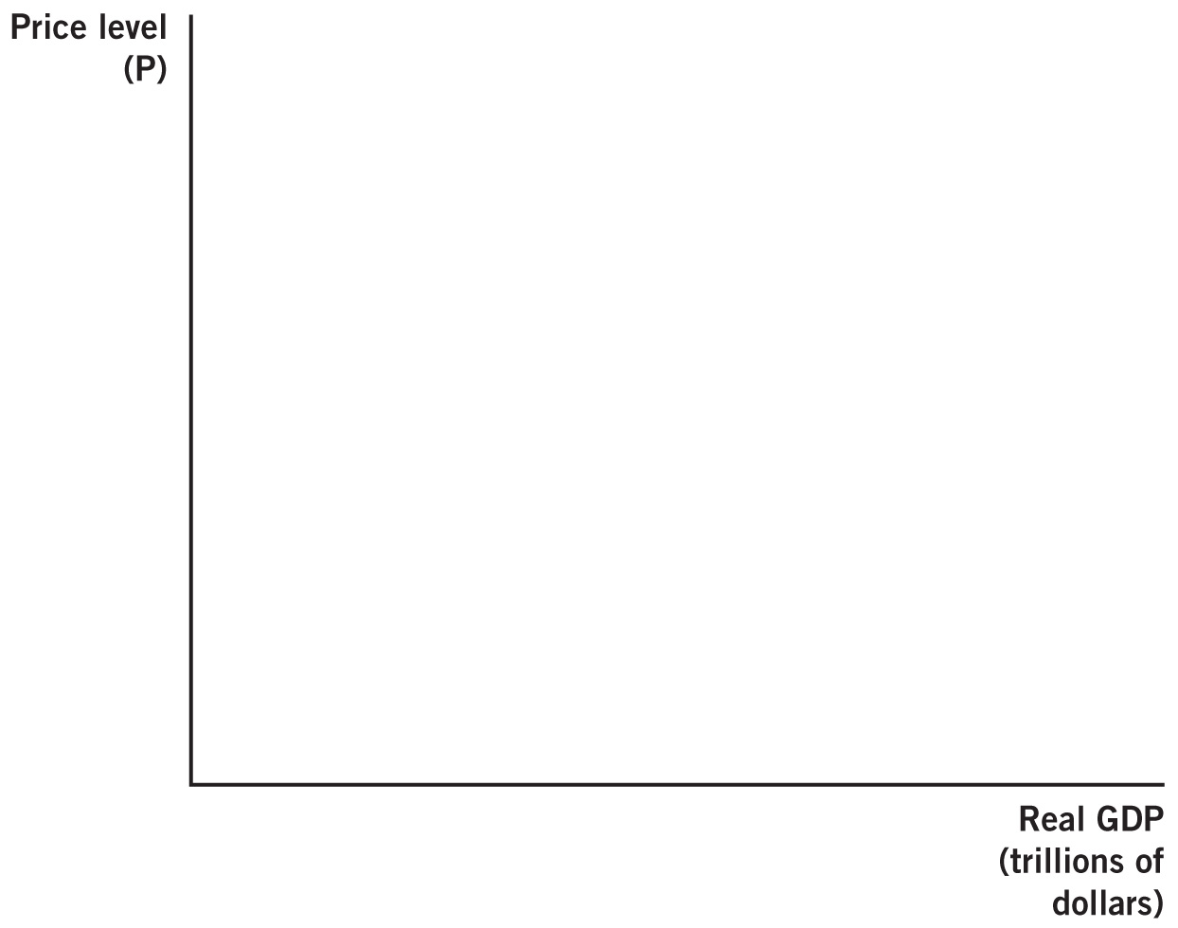

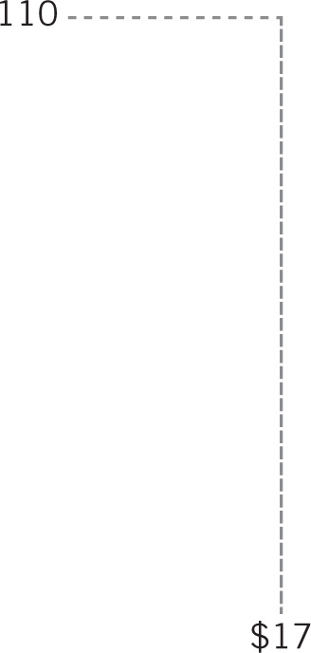
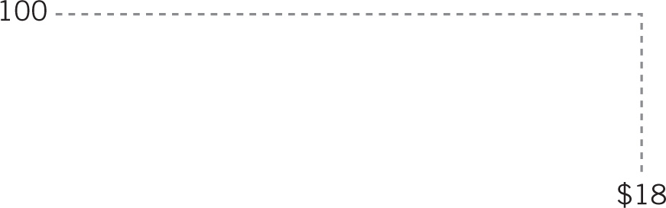

Slope of the AD Curve

Slide 14
Shift Factors in Aggregate Demand
When people’s demand for goods & services at all price levels changes, AD will shift.
The main categories are:
Consumption
Investment
Government Spending
Net Exports

Slide 15
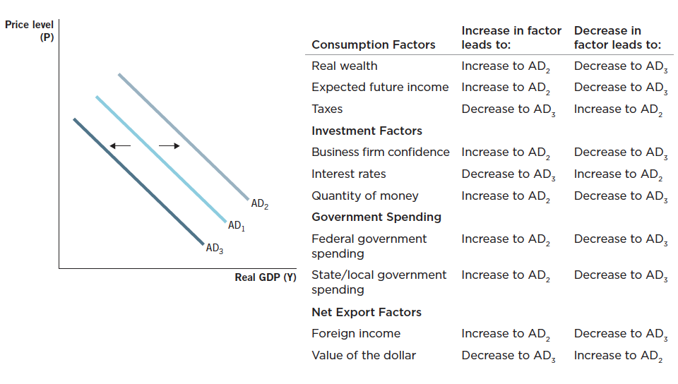
Shift Factors in AD Summary

Slide 16
Movements along the AD Curve versus Shifts in the AD Curve
Movement along the AD Curve
Start with a change in the price level.
Affect the quantity of AD through the 3 effects.
Examples: wealth effect, interest rate effect, international trade effect.
Shifts in the AD Curve
Occur when something other than the price level changes.
Examples: changes in real wealth, businesses confidence, value of the dollar.

Slide 17
Practice What You Know
Does each scenario below cause a movement along the AD curve or a shift in the AD curve?

Slide 18

Practice with Footballs
Price level
Using your football, illustrate what happens when consumers read positive economic news & then expect stronger future economic growth.
AD
Real GDP

Slide 19
Practice with Footballs
Price level
Using your football, illustrate what happens when due to an increase in the price level in the U.S., consumers buy less clothing made in the U.S. and more clothing made in Nicaragua.
AD
Real GDP

Slide 20
Practice with Footballs
Price level
Using your football, illustrate what happens when several European economies go into recession.
D
Real GDP

Slide 21
Practice with Footballs
Price level
Using your football, illustrate what happens when a decrease in the price level leads to greater real wealth & more savings, which reduces the interest rate and increases investment.
D
Real GDP

Slide 22
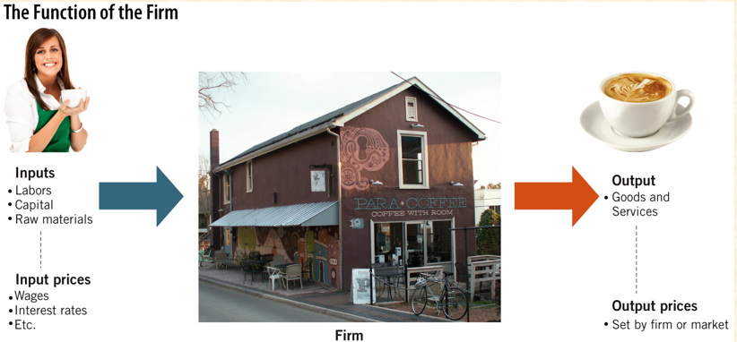
Function of a Firm

Slide 23

Aggregate Supply
How do changes in the price level affect the supply decisions of the firm?
It depends.
Economists use two different time horizons:
Long-run
Short-run

Slide 24
Long-Run AS (LRAS)
Long run: A period of time sufficient for all prices to adjust.
The level of output produced when an economy is at the natural rate of unemployment (u*).
It depends on an economy’s resources, technology, and institutions.
Vertical line:
Not affected by changes in price.
An economy’s ability to produce is the same regardless of how much paper money is present.

Slide 25
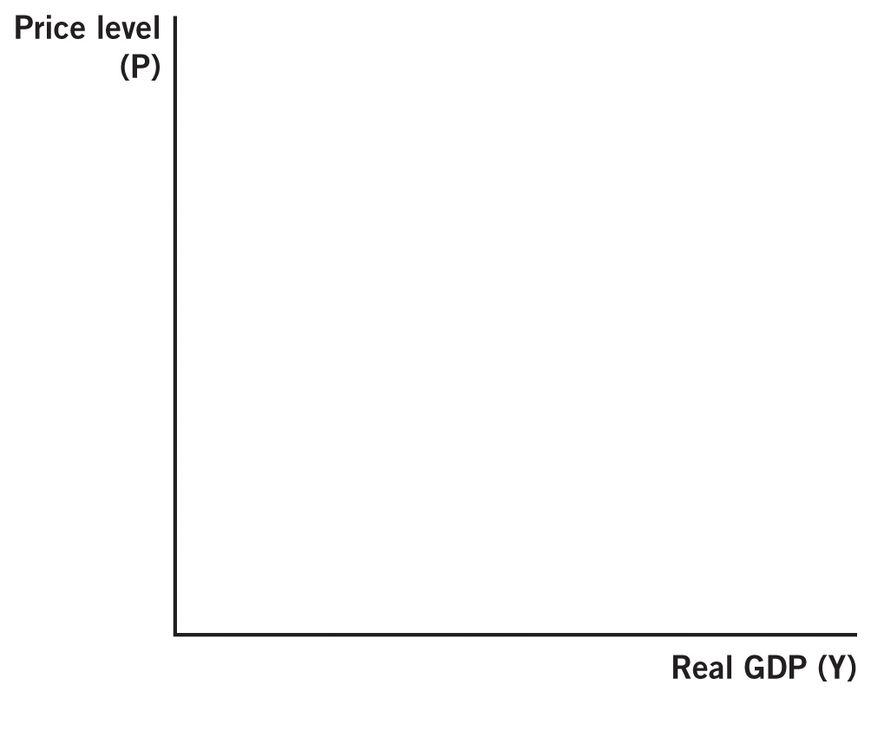
LRAS Curve
Y* = u = u*

Slide 26
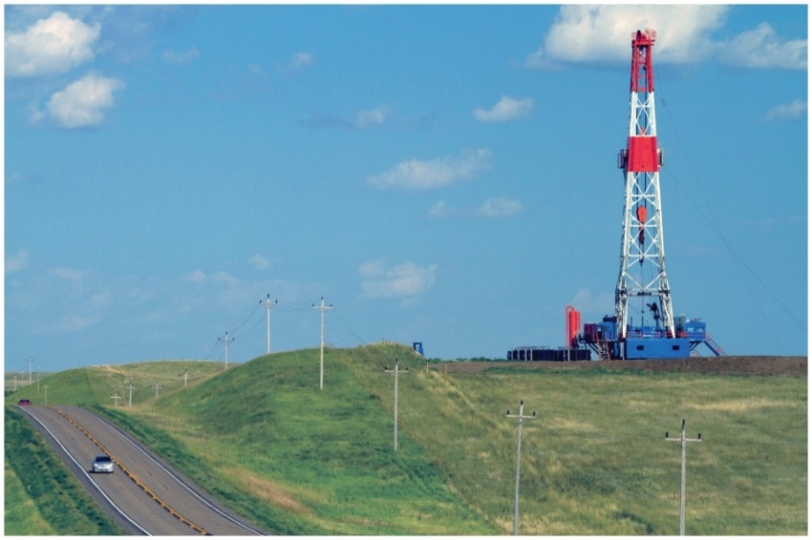
Shifts in LRAS
LRAS changes when a nation’s ability to produce output changes.
This occurs with changes in:
Resources
Technology
Institutions

Slide 27
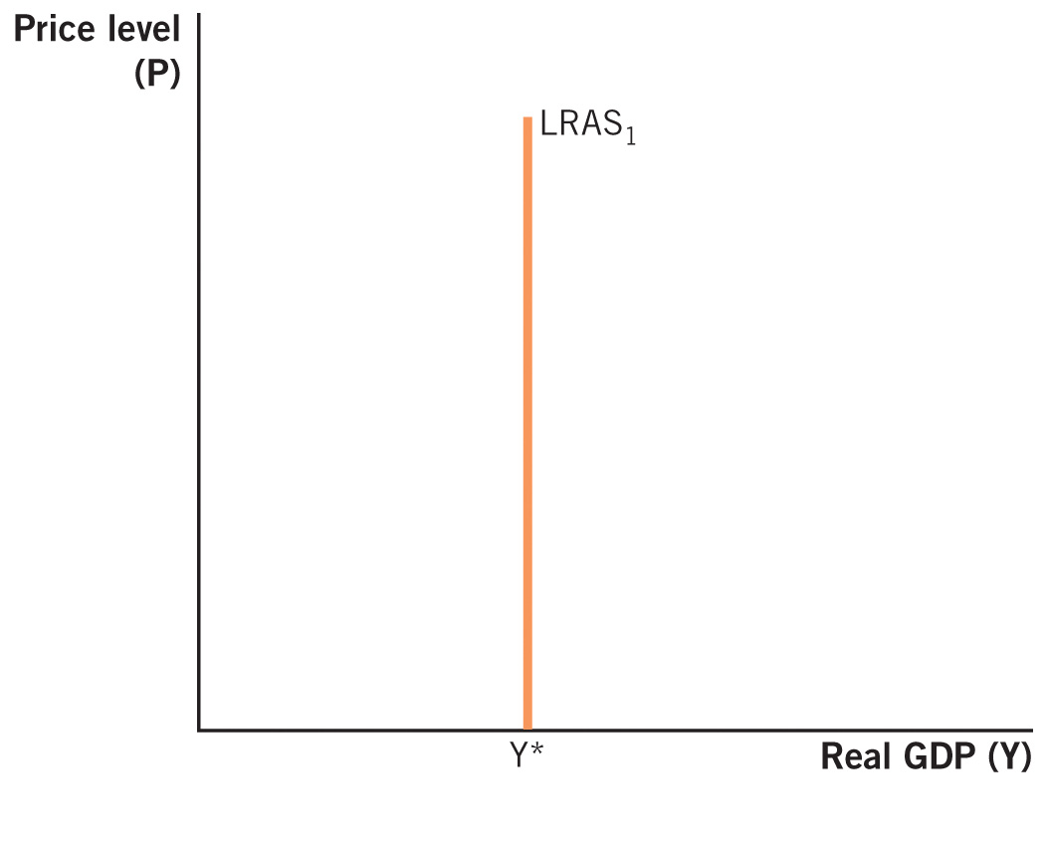
Shifts in Long-Run AS

Slide 28
Short-Run Aggregate Supply
Short run: The period of time in which some prices have not yet adjusted.
There are three reasons why there is a positive relationship between the price level and the quantity of aggregate supply:
1. Sticky input prices
2. Menu costs
3. Money illusion

Slide 29
Short-Run AS Curve

Slide 30

Sticky Input Prices
Resource (input) prices tend to be sticky.
Output prices can be changed easier & are more flexible.
Not all prices adjust at the same rate.
Suppose the aggregate price level is increasing (but input prices are fixed for the period):
Higher output price increases profit potential for firm.
Costs are not changing.
Firm responds by producing more output.

Slide 31
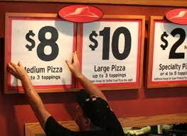
Menu Costs
Menu costs: the costs of changing prices.
Because of this expense, firms do not adjust their output price when the price level changes.
Buying from the firm is now relatively cheaper → consumers buy more.

Slide 32
Money Illusion
Occurs when people interpret nominal changes in wages or prices as real changes.
If there is deflation, workers are very reluctant to accept nominal wage cut, even if it is < the level of deflation.
Firms see revenues fall (reduced output prices) with no changes in costs
They reduce output: quantity of AS falls.

Slide 33
Shifts in Short-Run Aggregate Supply
Whenever the long-run AS curve shifts, it takes the short-run AS curve with it.
Factors that shift only the short-run AS curve:
Changes in resource prices
Changes in expectations of prices
Supply shocks: surprise events that change a firm’s production costs

Slide 34
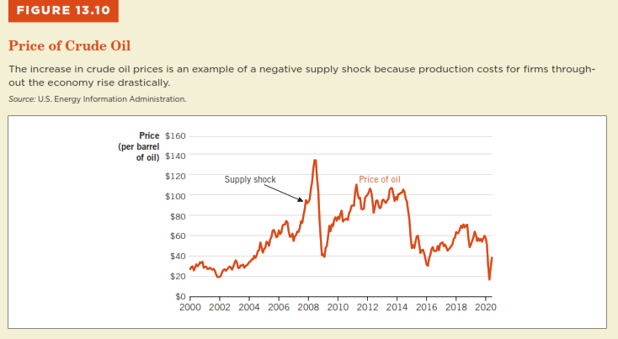

Slide 35
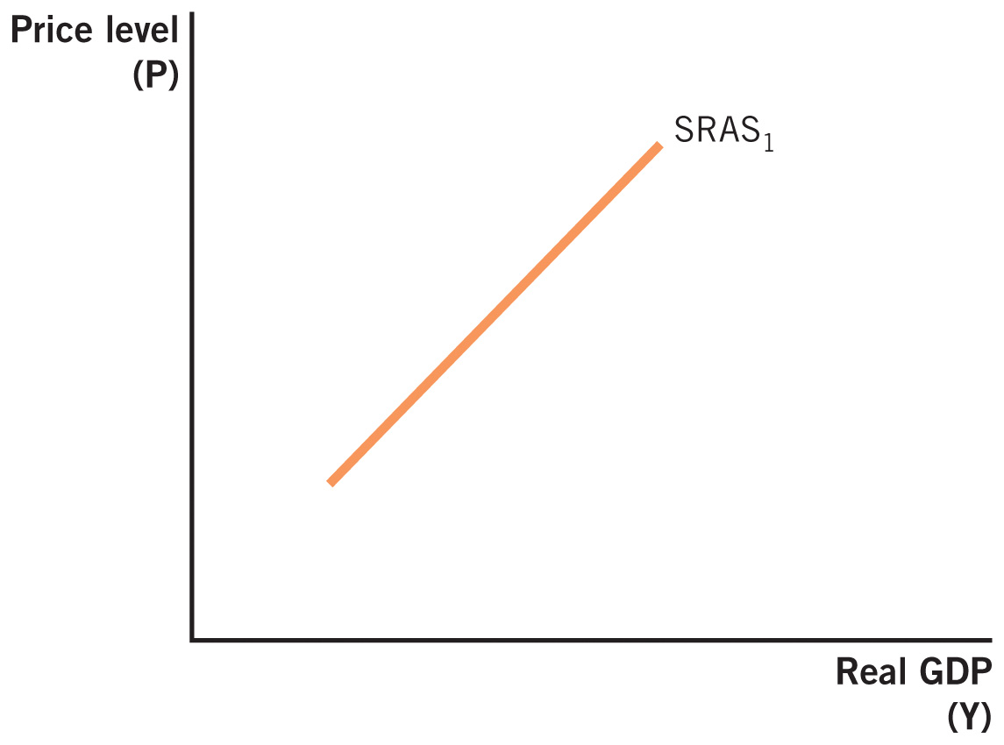

Factors That Shift the SRAS

Slide 36
Using the AD and AS Model
To determine how the economy moves from one long-run equilibrium to another:
Begin with the model in long-run equilibrium.
Determine which curve(s) are affected by the change(s) and the direction(s) of the change(s).
Shift the curve(s) in the appropriate direction(s).
Determine the new short-run and/or long-run equilibrium points.
Compare the new equilibrium(s) with the starting point.

Slide 37
Long-Run Equilibrium
Long-run equilibrium: Reached when the quantity of AD is equal to the quantity of AS in the short run & long run.
LRAS=SRAS=AD.
Delimited as “A.”
At this point:
The economy is at full employment.
The unemployment rate is equal to the natural rate.

Slide 38
Long-Run Equilibrium in the Economy

Slide 39

Shifts in the Long-Run AS: Technology Shock
Which curves shift?
Both LRAS and SRAS.
In what direction?
To the right.
What happens to output, employment, price level?
Output increases.
Unemployment stays the same
Price level goes down

Slide 40
Adjustment to a Shift in the Long-Run AS

Slide 41

Shift in the Short-Run AS (negative supply shock) (temp)
Suppose there is an important oil pipeline leak.
Which curves shift?
Just SRAS.
In what direction?
To the left.
What happens to output, employment & price level in the short run?
Output falls.
Unemployment increases.
Price level goes up.

Slide 42
Adjustment in the Short-Run (negative supply shock)

Slide 43
Adjustment in the Long-Run (negative supply shock)
How do we get back to long-run equilibrium?
Because SRAS shock is temporary, SRAS will shift back to the right.
What happens to output, employment, and price level in the long run?
Output stays the same.
Unemployment stays the same.
Price level stays the same.

Slide 44
Adjustment in the Long-Run (negative supply shock)

Slide 45

Shift in Aggregate Demand (expansion in AD)
Suppose that consumer confidence rises.
Which curves shift?
AD
What direction?
To the right.
What happens to output, employment, and price level in the short run?
Output increases
Unemployment goes down
Price level rises

Slide 46
Adjustment in the Short-Run (expansion in AD)

Slide 47
Adjustment in the Long Run (expansion in AD)
How do we get back to long-run equilibrium?
SRAS shifts left.
What happens to output, employment, and price level in the long run?
Output stays the same.
Unemployment stays the same
Price level goes

Slide 48
Adjustment in the Long Run (expansion in AD)

